Slide 1
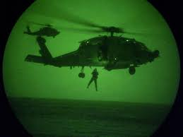
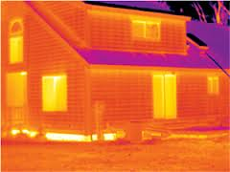

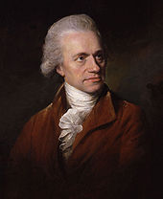
Why are CH₄ and NO₂ participate to global warming when H₂, N₂ and O₂ do not?
SECTION. I (CHAP. 15)
INFRARED SPECTROSCOPY
AND MASS SPECTROMETRY
Sir Friedrich Wilhelm Herschel (15 November 1738 – 25 August 1822) was a German-born British astronomer born in Hanover, Germany. He became famous for his discovery of the planet Uranus along with two of its major moons (Titania and Oberon) and also discovered two moons of Saturn. He discovered the existence of Infrared radiation.

Slide 2
FUNDAMENTAL CONCEPTS
Element of insaturation
Infrared and bond vibration: stretching and bending
Infrared and resonance
Mass spectrometry
Ionization and fragmentation
High resolution mass spectrometry
IR and structure elucidation

Slide 3
ELEMENTS OF INSATURATION
For a molecule with the following molecular formula C_{x}H_{y}O_{z}N_{t}Cl_{n}
C represents any atom that accepts 4 bonds
N represents any atom that accepts 3 bonds
O represents any atom that accepts 2 bonds
H and Cl represent any atom that accepts 1 bonds NI = x +1 – ½ (y + n) + ½ t
Oxygen and atoms that accept two bonds count for zero
1 degree of unsaturation = 1 unit on the hydrogen deficiency index (HDI)
Practice 15.31, 15.32 P. 723
Problem 15.54 P. 727
Number of elements of insaturation | May correspond to
1 | 1 double bond or 1 ring
2 | 1 triple bond, 2 double bonds, 1 double and 1 ring or 2 rings
3 | 1 triple bond and 1 double (or one ring) 3 double bonds or 3 rings 2 double bonds and 1 ring or 2 rings and 1 double bond
4 | Aromatic ring (etc…)

Slide 4
STRUCTURE ELUCIDATION
Determine the degree of unsaturation or the hydrogen deficiency index (HDI) in these molecules
(a) C₉H₁₁NO₃ (b) C₇H₁₁BrO₂ (c) C₅H₇NO (d) C₁₂H₉Cl₂NO₂
When an interesting compound is isolated from natural source, its structure must be completely determined before a synthesis is begun. Whenever we run a reaction, we must determine whether the product has the desired structure.
Elemental analysis, comparison of physical properties (melting point, boiling point etc…) with standard sample, and chemical tests used to be the standard methods for structural elucidation. However, these techniques are insufficient or completely useless for complex molecules. In this case, spectroscopic techniques must be used.
Spectroscopy is the study of the interaction of energy and matter. It finds applications in chemistry, biochemistry and in medicine.
Basically, they are the workhorse techniques for the study of both biological and non-biological molecular structures
And, unlike chemical tests, most spectroscopic techniques are nondestructive (it destroys little or no sample).

Slide 5
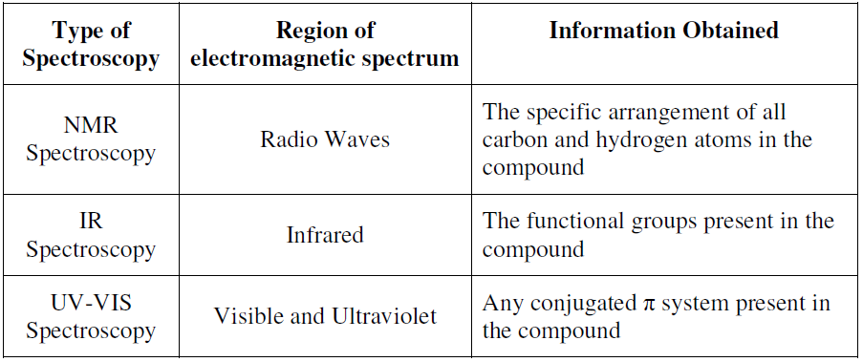
TYPES OF SPECTROSCOPY
There are four main spectroscopic or related techniques:
Ultraviolet (UV) spectroscopy uses electron transitions to determine bonding patterns.
Infrared (IR) spectroscopy measures the bond vibration frequencies in a molecule and is used to determine the functional group.
Mass spectrometry (MS) fragments the molecule and measures the masses.
Nuclear magnetic resonance (NMR) spectroscopy detects signals from atoms (H, C, P, F etc…) and can be used to distinguish isomers.
Absorption spectroscopy is the measurement of the amount of electromagnetic radiation absorbed by compound as a function of the wavelength or intensity.

Slide 6
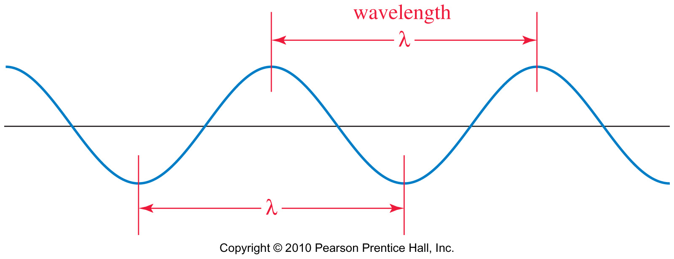
THE ELECTROMAGNETIC SPECTRUM
Wavelength and Frequency
The frequency of a wave is the number of complete cycles that pass a fixed point in a second.
Wavelength is the distance between any two peaks (or any two troughs) of the wave.
Frequency and wavelength are inversely proportional.
c = λν, where c is the speed of light c = 3 x 10⁸ m/s
E _{(energy per photon)} = hν = hc/λ where h is Planck’s constant, 6.62 x 10⁻³⁷ kJ•sec.

Slide 7
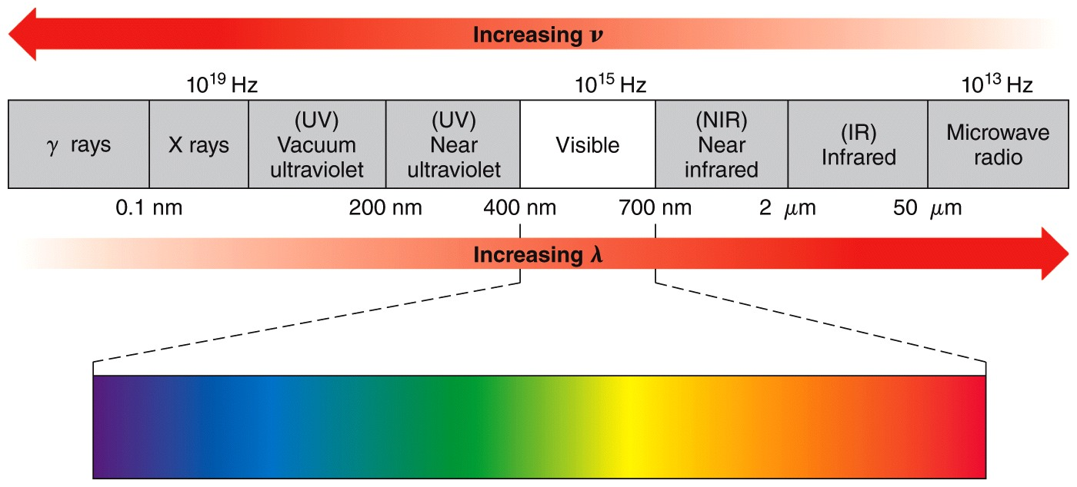
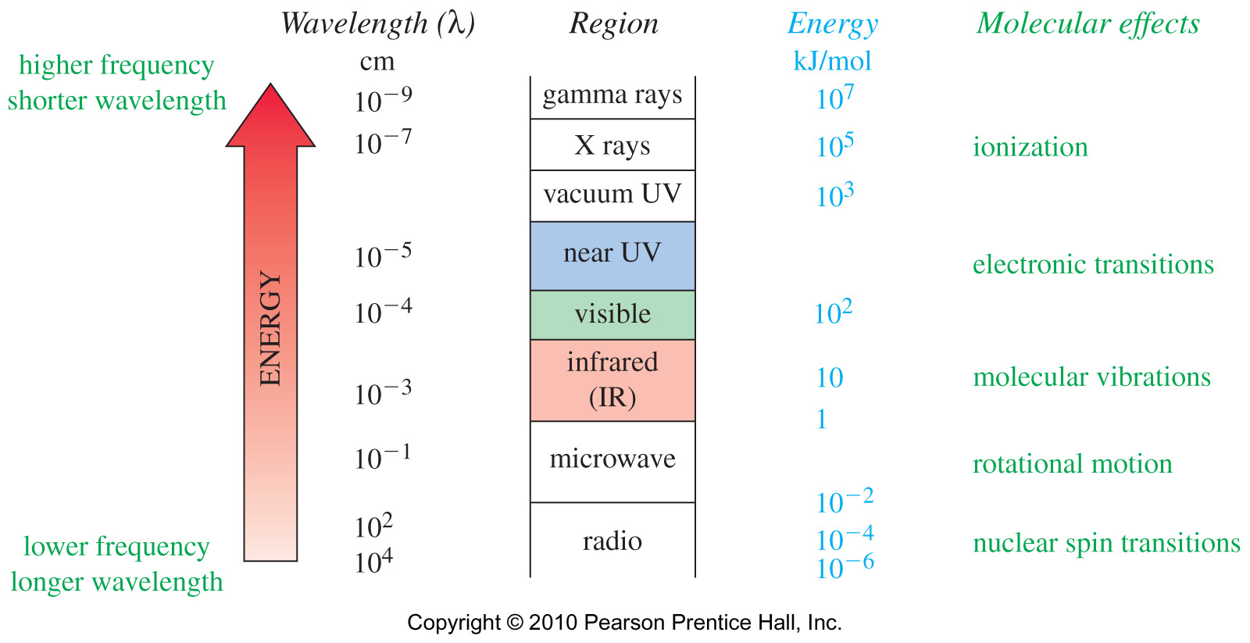
THE ELECTROMAGNETIC SPECTRUM

Slide 8
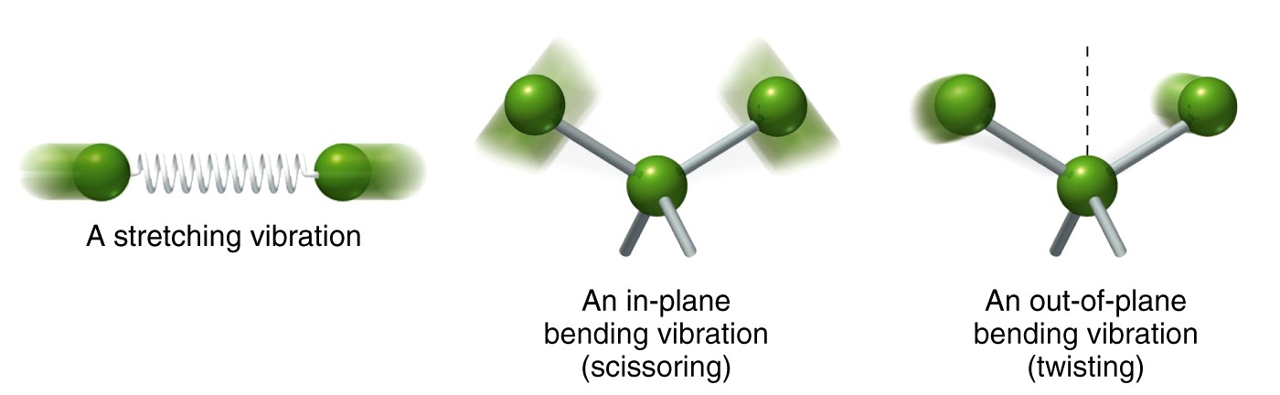
THE INFRARED (IR) SPECTROSCOPY
The infrared (from Latin, infra meaning below) region of the spectrum is just below red in the visible region of the spectrum and correspond to the wavelengths between 2.5-25 μm.
The position of an infrared band is specified by its wavelength (λ), measured in microns (μm). However, a more common unit is the wavenumber, (cm⁻¹), the reciprocal of the wavelength in centimeters. Wavenumbers are proportional to frequency and energy.
Before discussing the characteristic of infrared absorptions, it’s helpful to understand some theory about the vibrational energies of molecules.

Slide 9
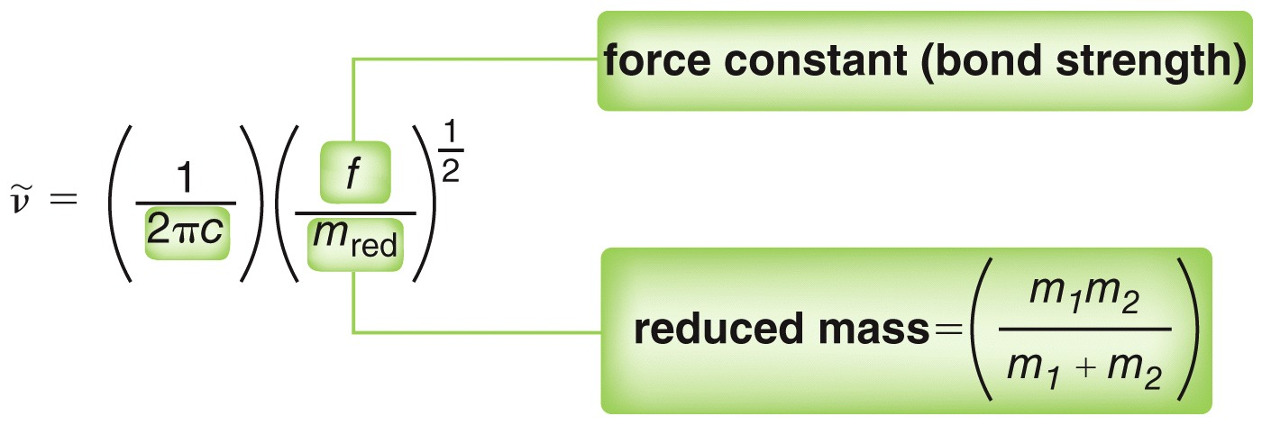
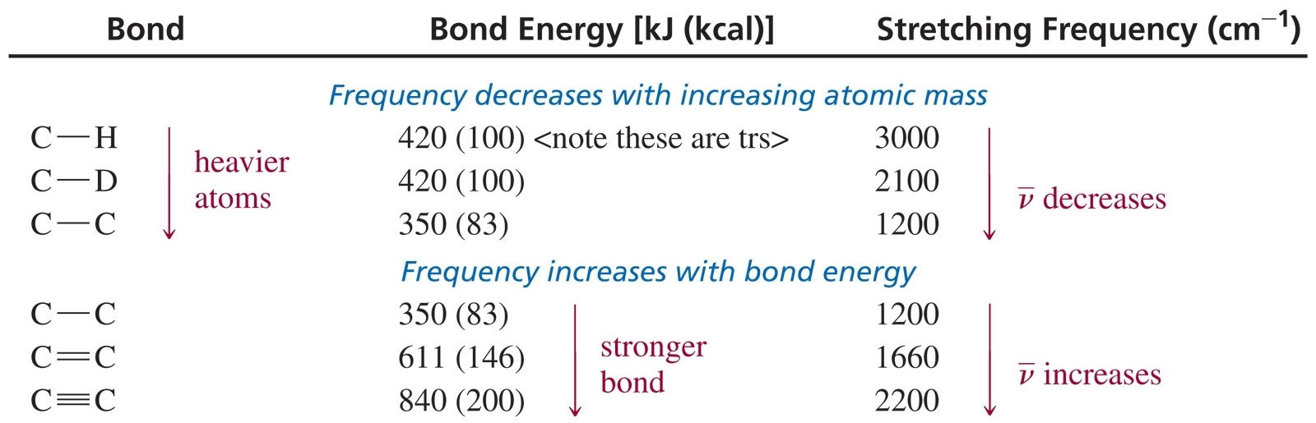
THE INFRARED (IR) SPECTROSCOPY
The wavenumber for a stretching vibration depends on the bond strength and the mass of the atoms bonded together.

Slide 10
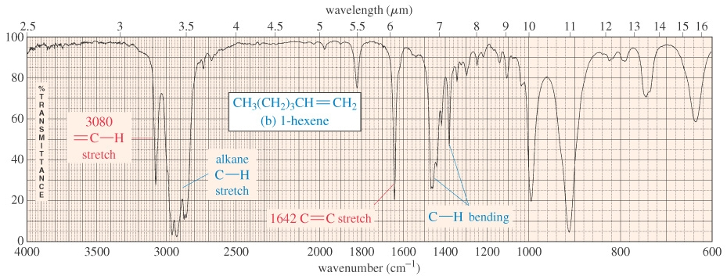
THE INFRARED (IR) SPECTROSCOPY
A nonlinear molecule with n atoms generally has 3n - 6 fundamental vibrational modes.
Whole-molecule vibrations and bending vibrations are also quantized.
No two molecules will give exactly the same IR spectrum (except enantiomers).
Simple stretching: 1400-3500 cm⁻¹.
Complex vibrations: 600-1400 cm⁻¹, called the “fingerprint region.”

Slide 11
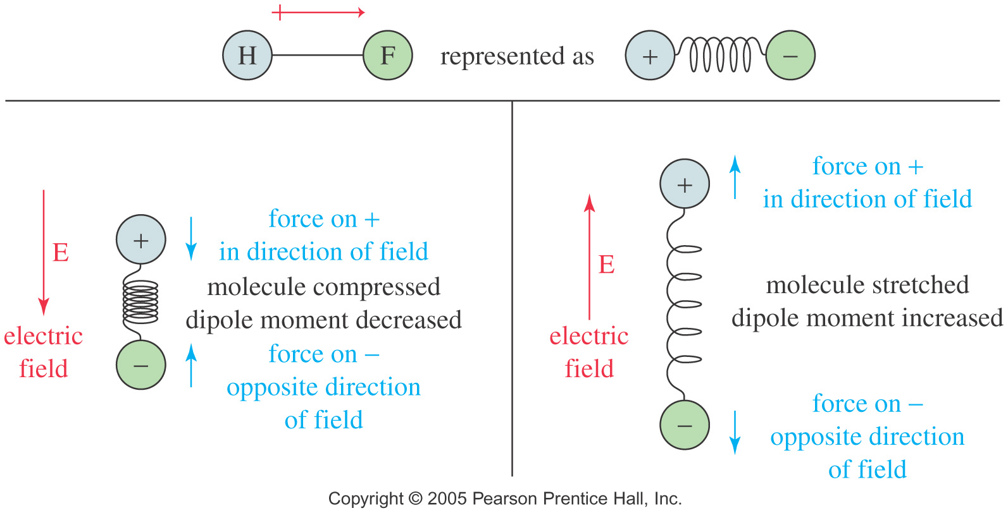
THE INFRARED (IR) SPECTROSCOPY
Not all molecular vibrations absorb infrared radiation.
A polar bond is usually IR-active.
A nonpolar bond in a symmetrical molecule will absorb weakly or not at all.

Slide 12
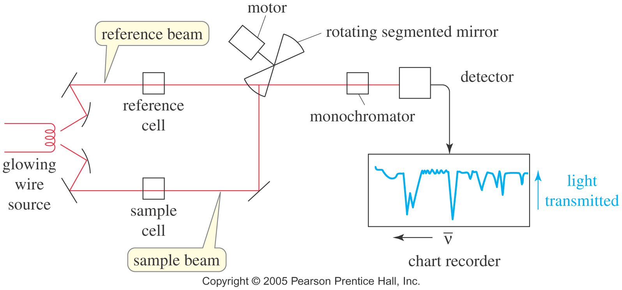
THE INFRARED (IR) SPECTROSCOPY
An Infrared Spectrometer (Dispersive instrument)
IR spectra can be measured using liquid (CH₂Cl₂, CCl₄ or CS₂ are the common solvents), solid (NaCl or KBr plates) or gaseous samples that are placed in the beams of infrared light.
The detector signal is proportional to the difference in the intensity of light in the sample and reference beams, with the reference beam compensating for any absorption by air or by the solvent.

Slide 13
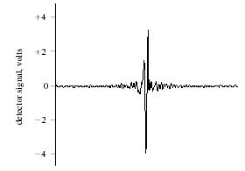
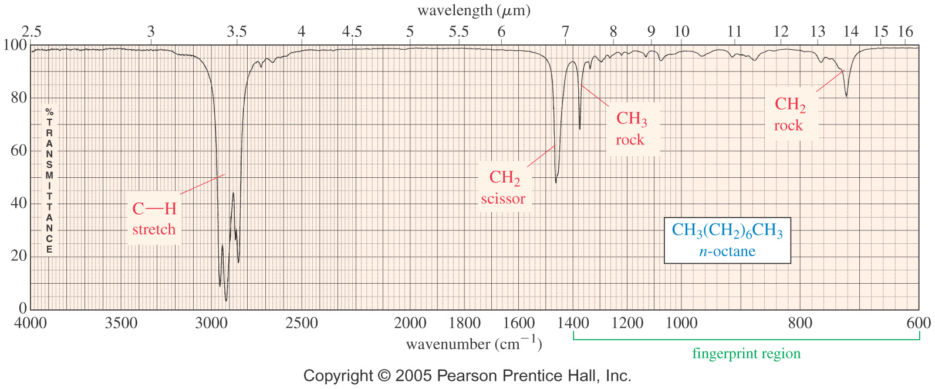
THE INFRARED (IR) SPECTROSCOPY
The Fourier transform infrared spectrometer (FT-IR)
The interferogram at the left displays the interference pattern and contains all of the spectrum information.
A Fourier transform converts the time domain into the frequency domain with absorption as a function of frequency.

Slide 14
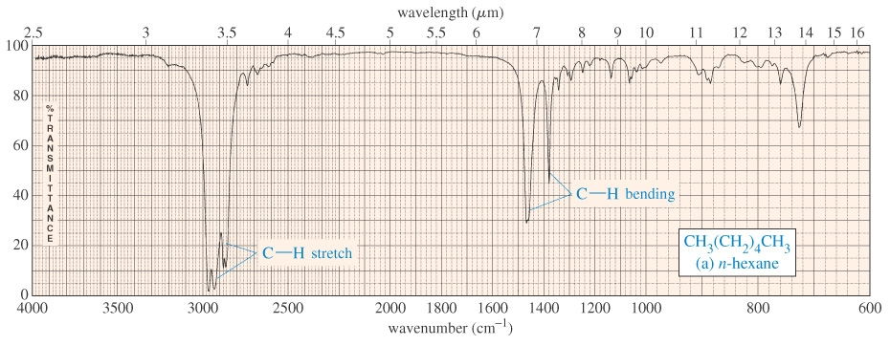
INFRARED AND FUNCTIONAL GROUPS
An Alkane (sp³) IR Spectrum
An Alkene (sp²) IR Spectrum

Slide 15
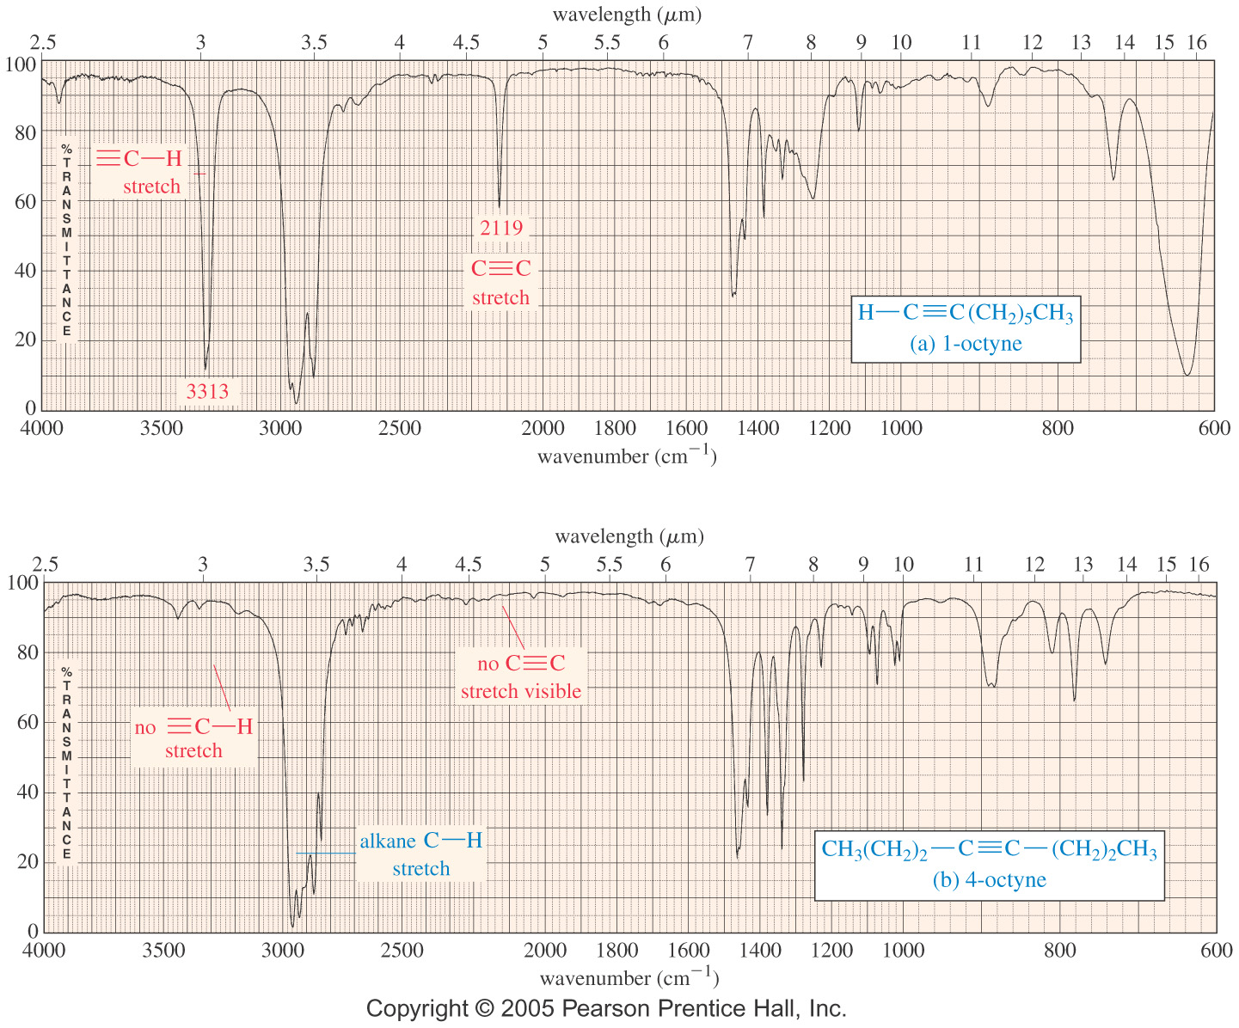
INFRARED AND FUNCTIONAL GROUPS
An Alkyne (sp) IR Spectrum

Slide 16
INFRARED AND FUNCTIONAL GROUPS
O-H and N-H Stretching
Both of these occur around 3300 cm⁻¹, but they look different.
Alcohol O-H, broad with rounded tip.
Secondary amine (R₂NH), broad with one sharp spike.
Primary amine (RNH₂), broad with two sharp spikes.
No signal for a tertiary amine (R₃N).
However, if you have an hydroxyl group together with a primary or a secondary amine in the same molecule, it becomes difficult, if not impossible to distinguish between the absorption of both functional groups as they overlap or appear one on top of another

Slide 17
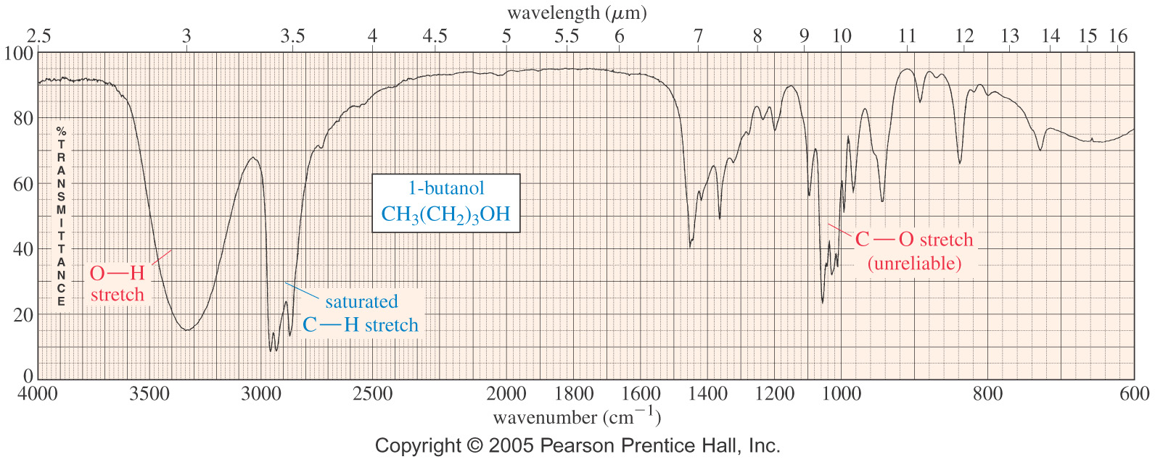
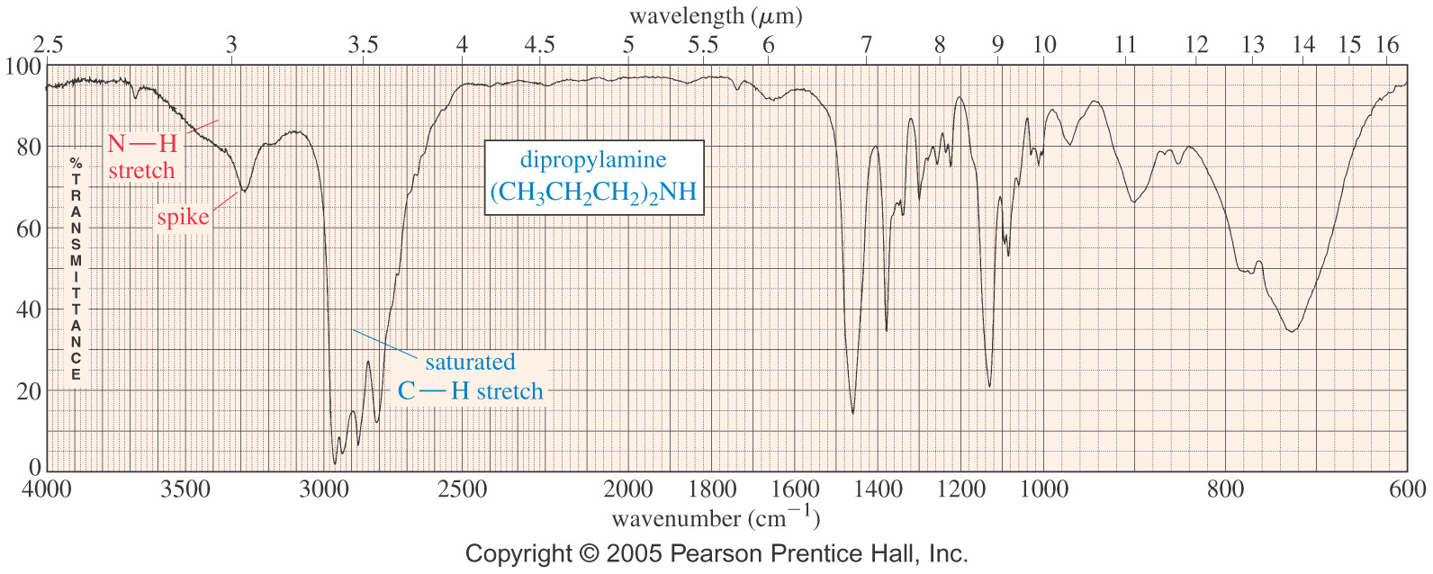
INFRARED AND FUNCTIONAL GROUPS
An Alcohol IR Spectrum
An Amine IR Spectrum

Slide 18
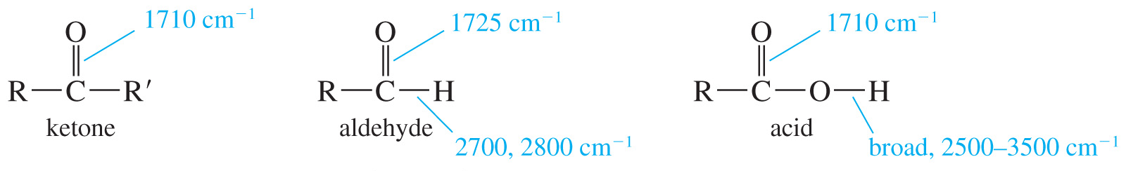
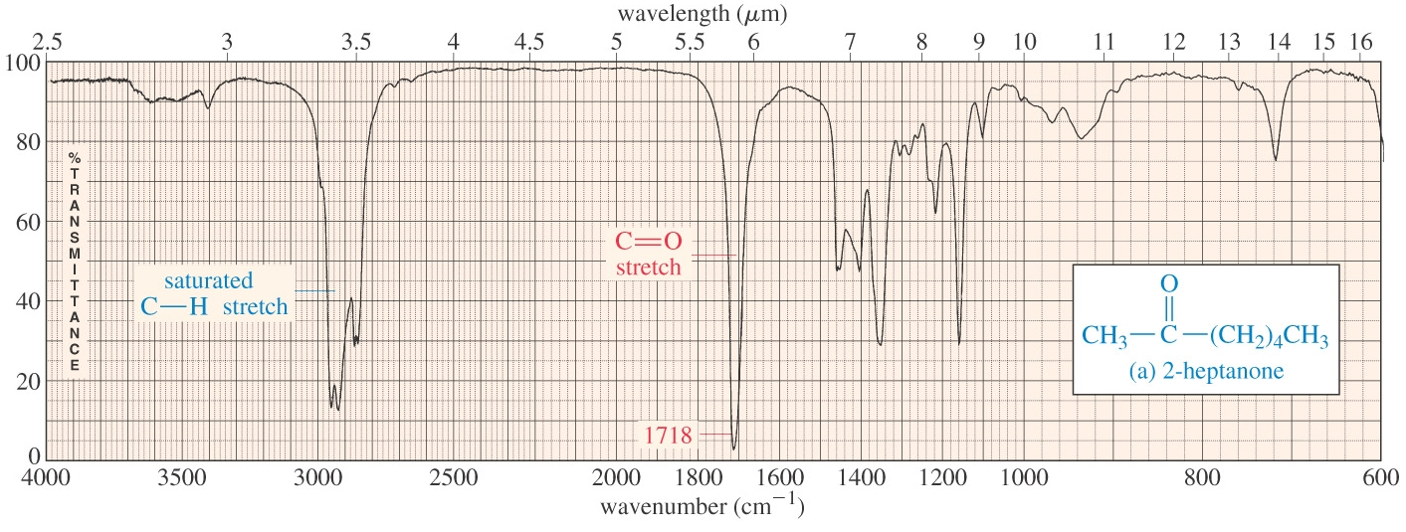
INFRARED AND FUNCTIONAL GROUPS
Carbonyl Stretching
A Ketone IR Spectrum
overtone

Slide 19
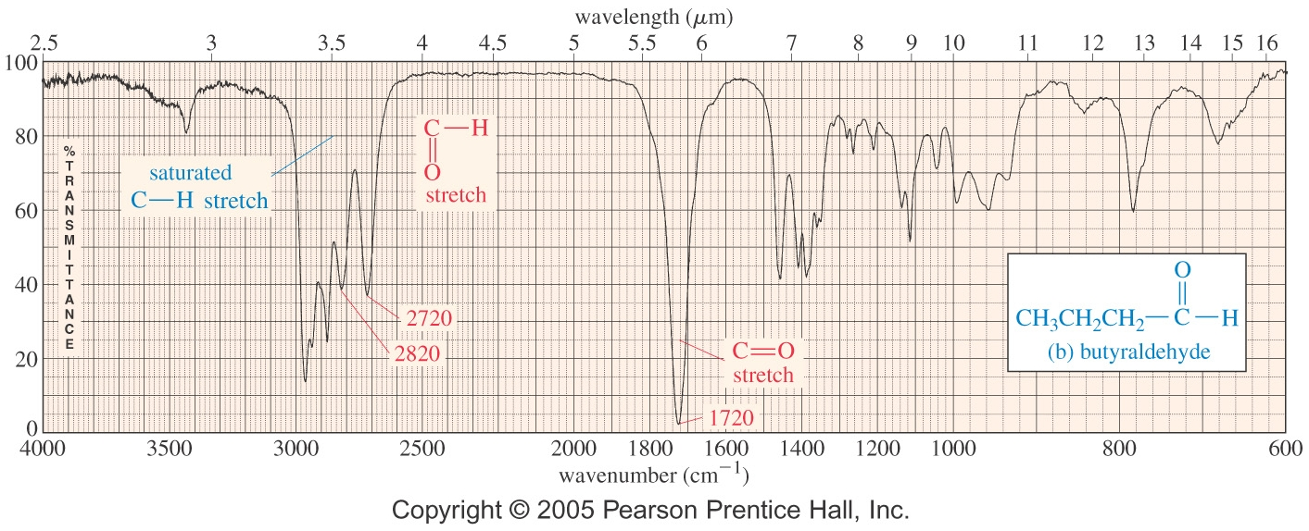
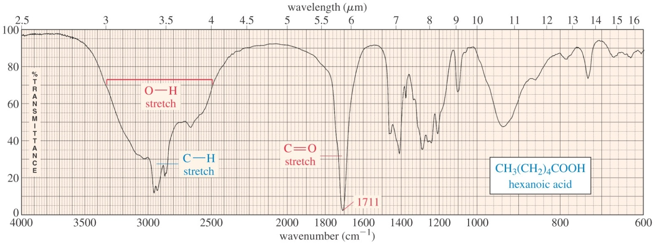
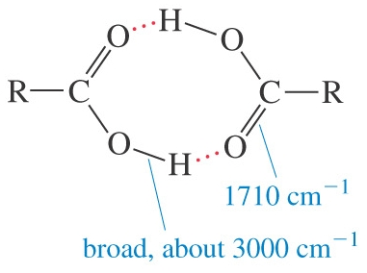
INFRARED AND FUNCTIONAL GROUPS
An Aldehyde IR Spectrum
O-H Stretch of a Carboxylic Acid
overtone

Slide 20
INFRARED AND FUNCTIONAL GROUPS
Variations in C=O Absorption
Conjugation of C=O with C=C lowers the stretching frequency to ~1680 cm⁻¹.
The C=O group of an amide absorbs at an even lower frequency, 1640-1680 cm⁻¹.
The C=O of an ester absorbs at a higher frequency, ~1730-1740 cm⁻¹, and carbonyl groups in small rings (5 C’s or less) absorb at an even higher frequency

Slide 21
INFRARED AND FUNCTIONAL GROUPS
Examples:
1. How could IR spectroscopy be used to distinguish between the following pair of compounds?
2. You ran the following reaction in the lab. Predict the major signals and their relative area in the IR spectra for both the product and the reactant. Explain how IR spectroscopy could be used to check if the reaction worked.
Practice 15.2 to 15.4 P. 693, 15.14 P. 716

Slide 22
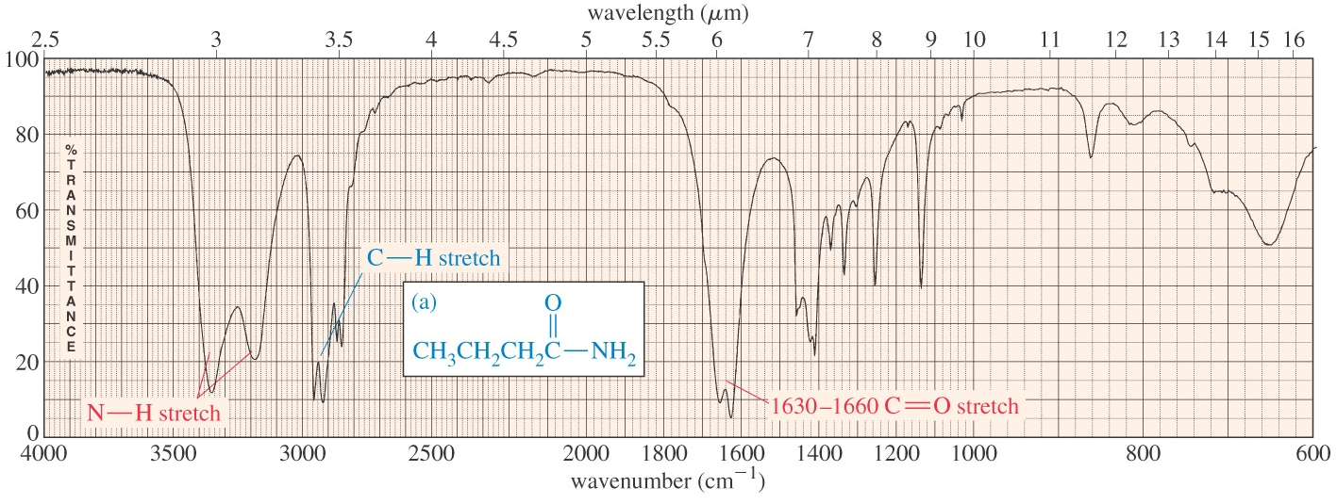
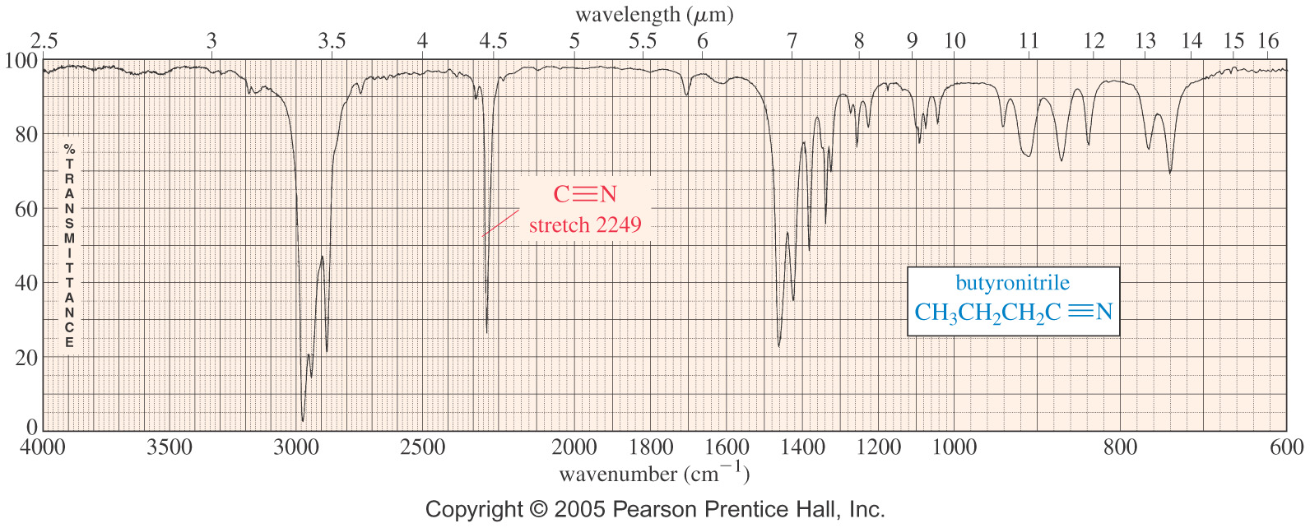
INFRARED AND FUNCTIONAL GROUPS
An Amide IR Spectrum
A Nitrile IR Spectrum

Slide 23
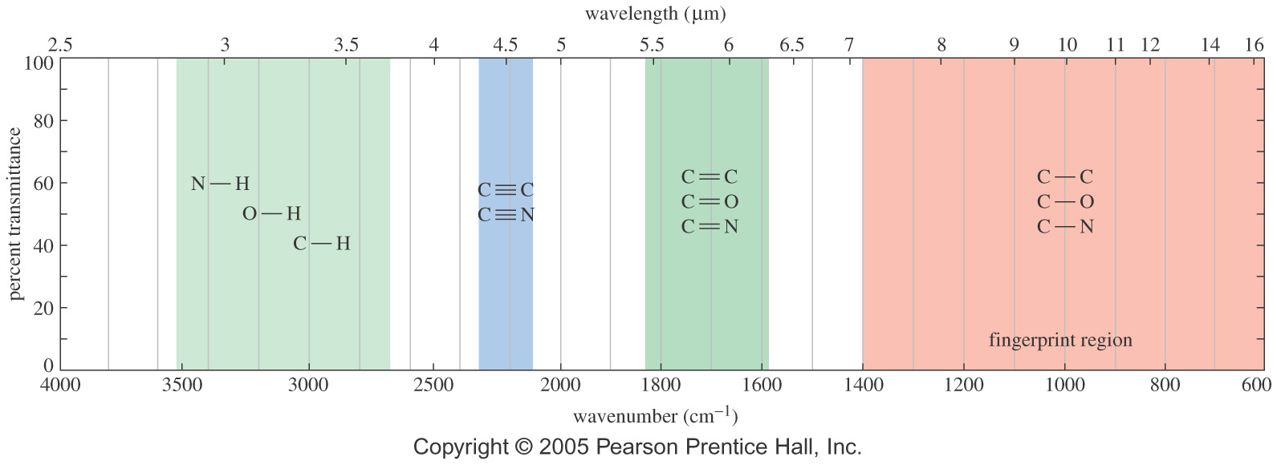
SUMMARY OF IR ABSORPTIONS
Carbon - Nitrogen Stretching
C - N absorbs around 1200 cm⁻¹. C – O stretching absorption is between 1000 – 1200 cm⁻¹
C = N absorbs around 1660 cm⁻¹ and is much stronger than the C = C absorption in the same region.
C ≡ N absorbs strongly just above 2200 cm⁻¹. while alkyne C ≡ C signal is much weaker and is just below 2200 cm⁻¹

Slide 24
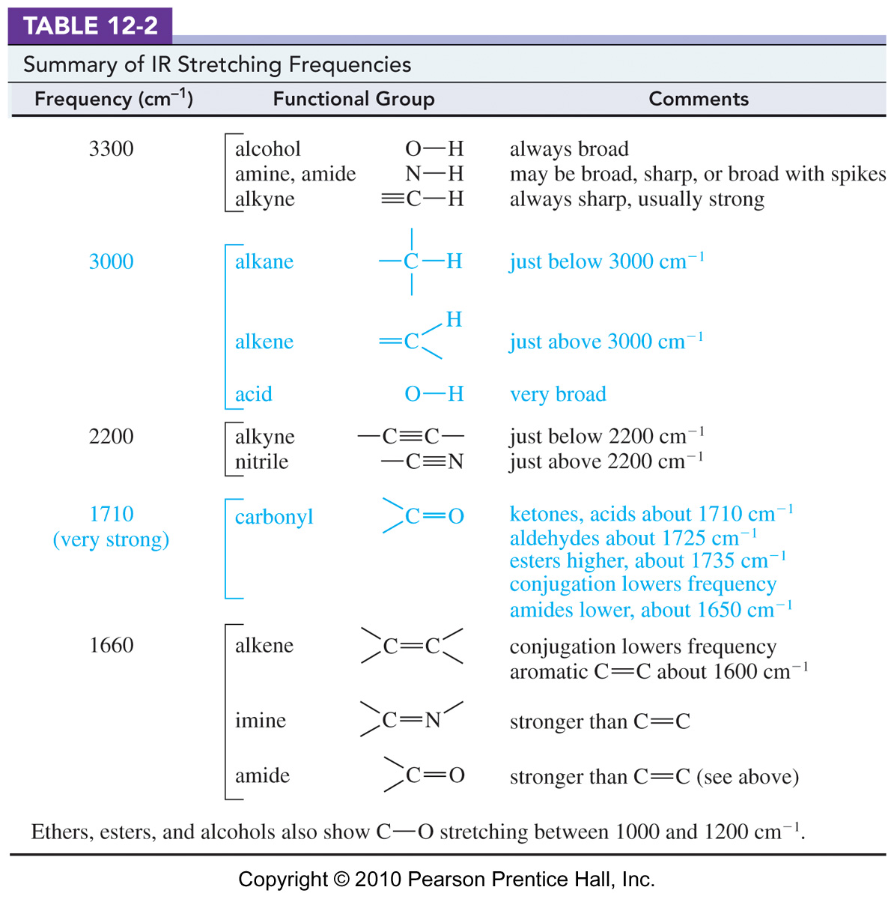
SUMMARY OF IR ABSORPTIONS

Slide 25
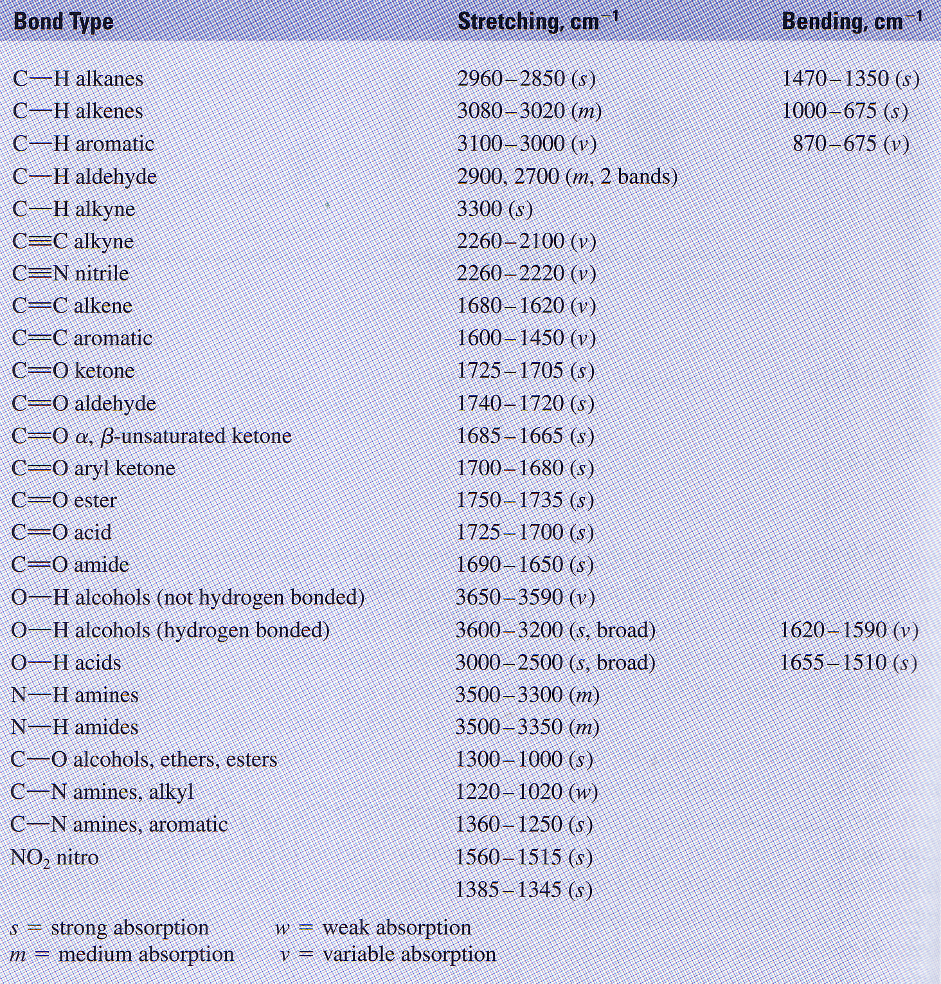
SUMMARY OF IR ABSORPTIONS

Slide 26
LIMITATIONS OF IR SPECTROSCOPY
The functional group is usually indicated
The absence of a signal is definite proof that the functional group is absent
Correspondence with a known sample’s IR spectrum confirms the identity of the compound
However
Some signals may be ambiguous due to overlaps
IR alone cannot determine a structure
Examples
Deduce a possible structure for the following compounds compound from their IR absorptions below.
1. C₇H₁₆O IR (cm⁻¹): 3200-3600 (broad), 2950 cm⁻¹
2. C₉H₇Cl IR (cm⁻¹): 3050, 2950, 2220, 1620 cm⁻¹
Practice 15.33 to 15.37 P. 724
Problems 15.38 to 15.42 P. 726

Slide 27
MASS SPECTROMETRY
Infrared spectroscopy gives information about the functional groups in a molecule, but it tells little about the size of the molecule or what heteroatoms are present. To determine a structure, we need a molecular weight and a molecular formula.
Molecular formulas were once obtained by careful analysis of the elemental composition, and the molecular weight was determined by freezing-point depression or some other technique. These are long and tedious processes, and require a large amount of extra-pure material.
Today, molecular weight can be obtained from a very small sample using mass spectrometry. Mass spectrometry (MS) provides the molecular weight and valuable information about the molecular formula.
High-resolution mass spectrometry (HRMS) can provide an accurate molecular formula.
Mass spectrometry does not involve the absorption or emission of light.
A beam of high-energy electrons breaks the molecule apart.
The masses of the fragments and their relative abundance reveal information about the structure of the molecule

Slide 28
ELECTRON IMPACT IONIZATION
Generally speaking, a mass spectrometer ionizes molecules in a high vacuum, sorts the ions according to their masses, and records the abundance of ions of each mass.
In electron impact ionization (EIMS) process, the sample is bombarded by a beam of electrons. These high-energy electrons can dislodge an electron from a bond, creating a radical cation (a positive ion with an unpaired e-).
FAB: Fast Atomic Bombardment
ESIMS: Electron Spray Ionization
MALDITOFF: Matrix Assisted Laser Desorption Ionization Time of Flight

Slide 29
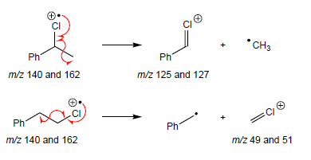
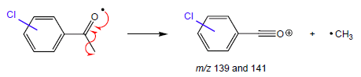
IONIZATION AND FRAGMANTATION

Slide 30
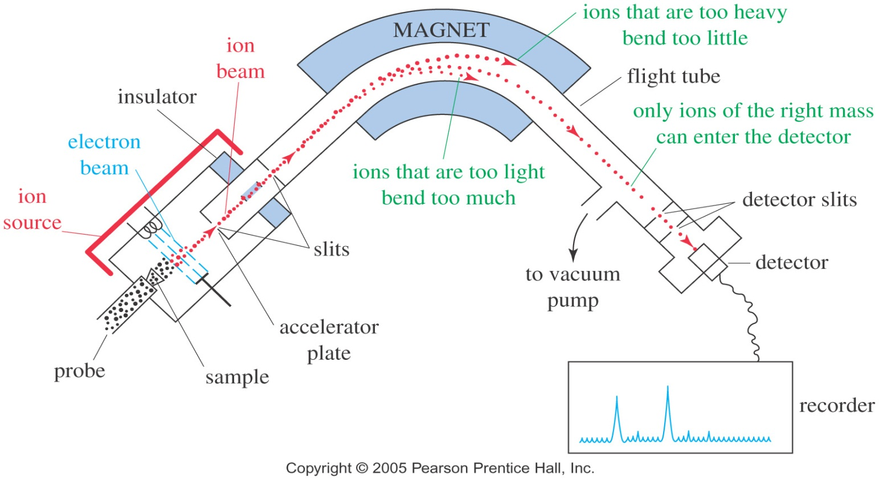
SEPARATION OF IONS
Once ionization and fragmentation have formed a mixture of ions, these ions are separated and detected.
However,
Only the cations are deflected by the magnetic field.
Amount of deflection depends on m/z.
The detector signal is proportional to the number of ions hitting it.
By varying the magnetic field, ions of all masses are collected and counted

Slide 31
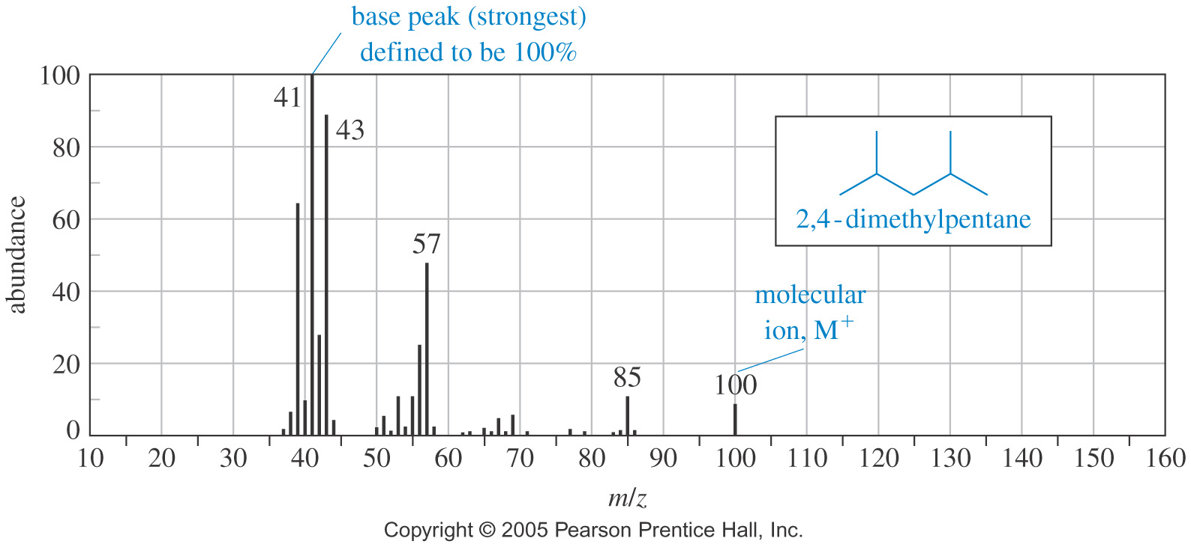
THE MASS SPECTRUM
Masses are graphed or tabulated according to their relative abundance

Slide 32
THE HIGH RESOLUTION MS
Although mass spectra usually show the particle masses rounded to the nearest whole number, the masses are not really integrals.
However, the determination of a molecular formula is possible using a high-resolution mass spectrometer (HRMS), one that uses extra stages of electrostatic or magnetic focusing to form a very precise beam and to detect particle masses to an accuracy of about 1 part in 20,000.
A mass determined to several significant figures using an HRMS is called an exact mass.
A molecule with mass of 44 could be C₃H₈, C₂H₄O, CO₂, or CH₄N₂.
If a more exact mass is 44.029, pick the correct structure from the table:
C₃H₈ C₂H₄O CO₂ CH₄N₂
44.06260 44.02620 43.98983 44.03740

Slide 33
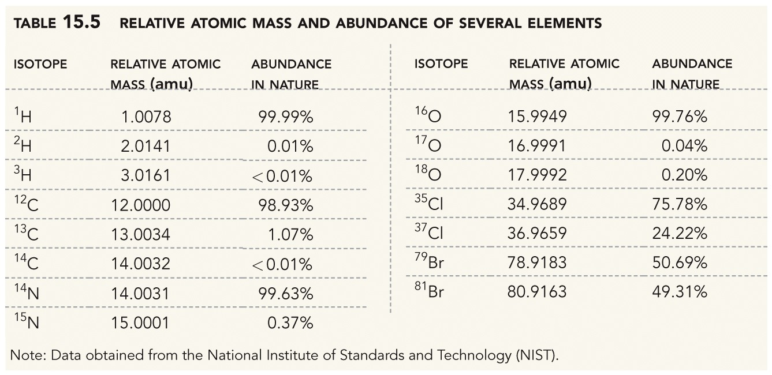
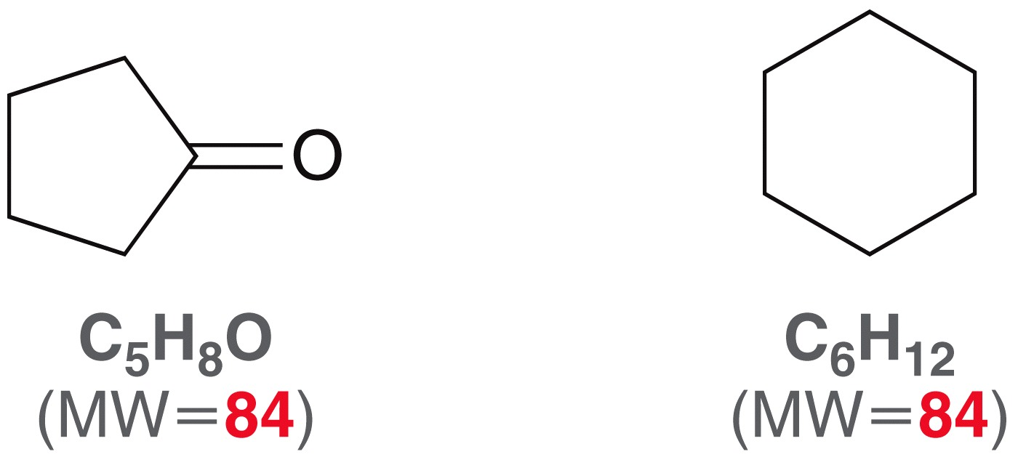
THE HIGH RESOLUTION MS

Slide 34
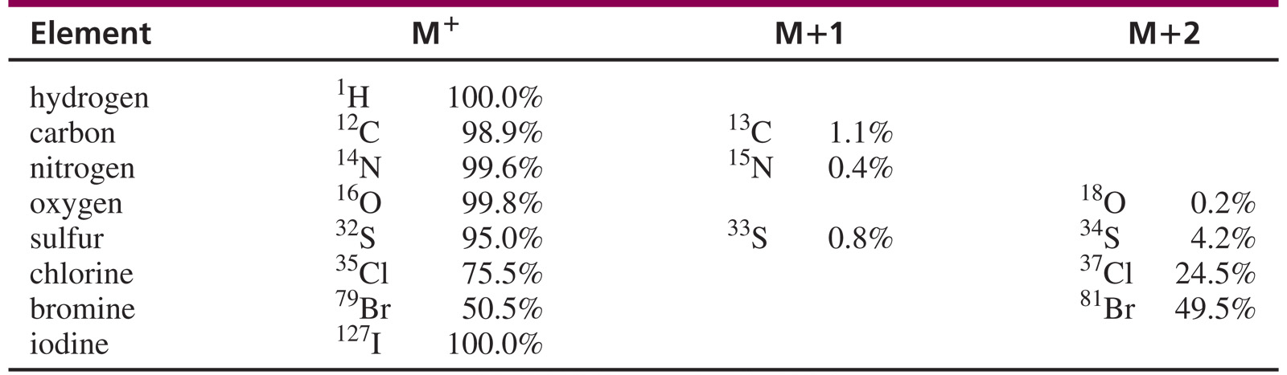
MOLECULES WITH HETEROATOMS
Isotopes: present in their usual abundance.
Hydrocarbons contain 1.1% C-13, so there will be a small M+1 peak.
If Br is present, M+2 is equal to M⁺.
If Cl is present, M+2 is one-third of M⁺.
If iodine is present, peak at 127, large gap.
If N is present, M⁺ will be an odd number.
If S is present, M+2 will be 4% of M⁺.
Isotopic Abundance

Slide 35
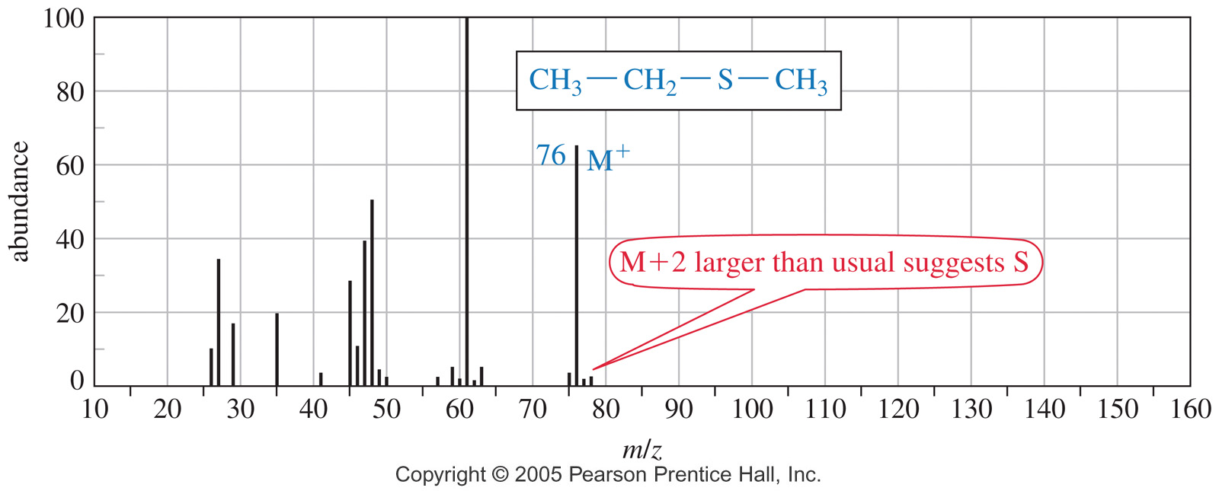
MOLECULES WITH HETEROATOMS
Mass spectrum of a compound with a sulfur in their structure

Slide 36
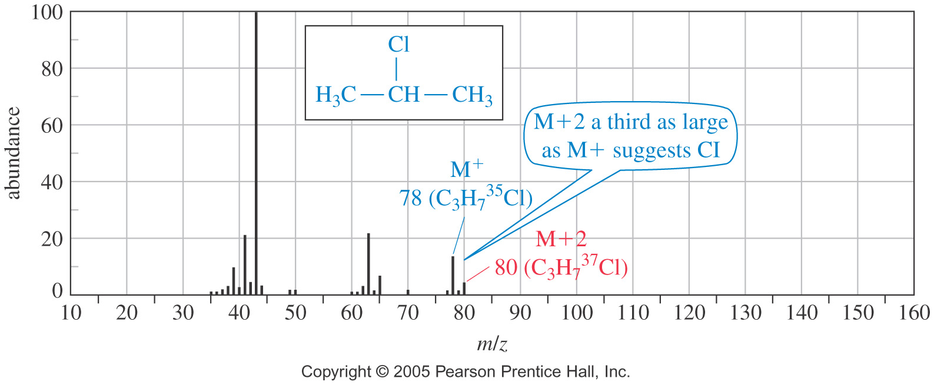
MOLECULES WITH HETEROATOMS
Mass spectrum of a compound with a chlorine in their structure

Slide 37
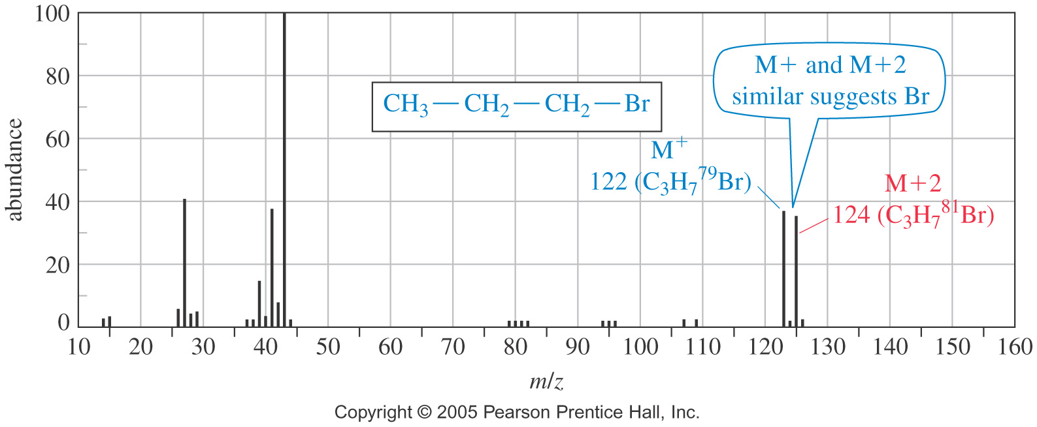
MOLECULES WITH HETEROATOMS
Mass spectrum of a compound with a bromine in their structure

Slide 38
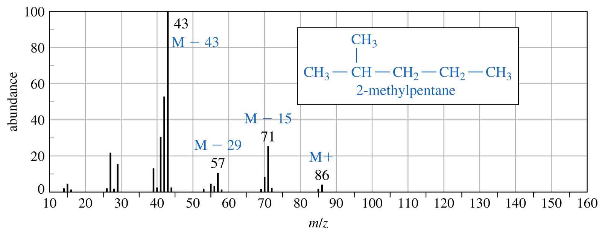
FRAGMENTATION PATTERNS
Mass spectrum of alkanes
More stable carbocation radicals will be more abundant

Slide 39
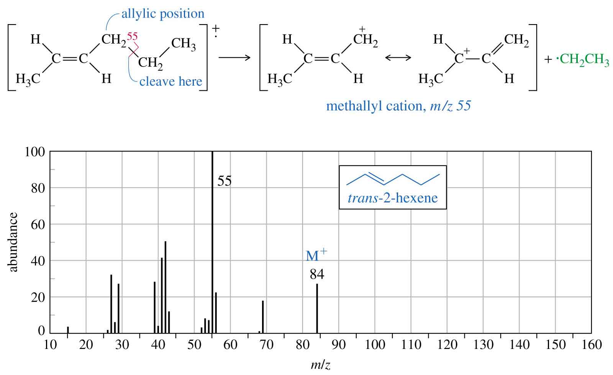
FRAGMENTATION PATTERNS
Mass spectrum of alkenes
Resonance-stabilized cations are favored.

Slide 40
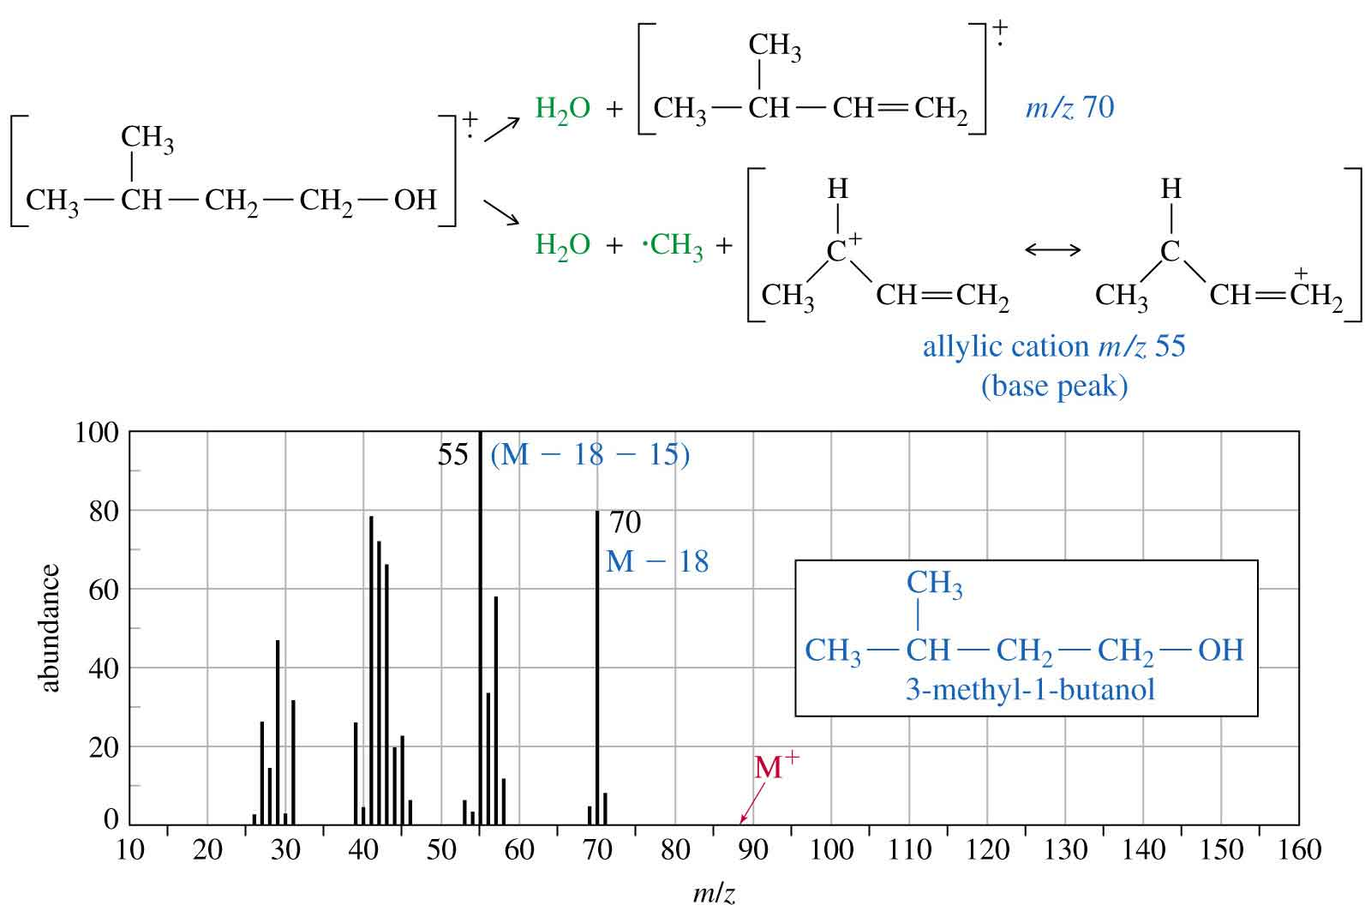
FRAGMENTATION PATTERNS
Mass spectrum of alcohols
Alcohols usually lose a water molecule.
M⁺ may not be visible.

Slide 41
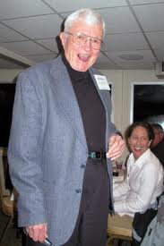
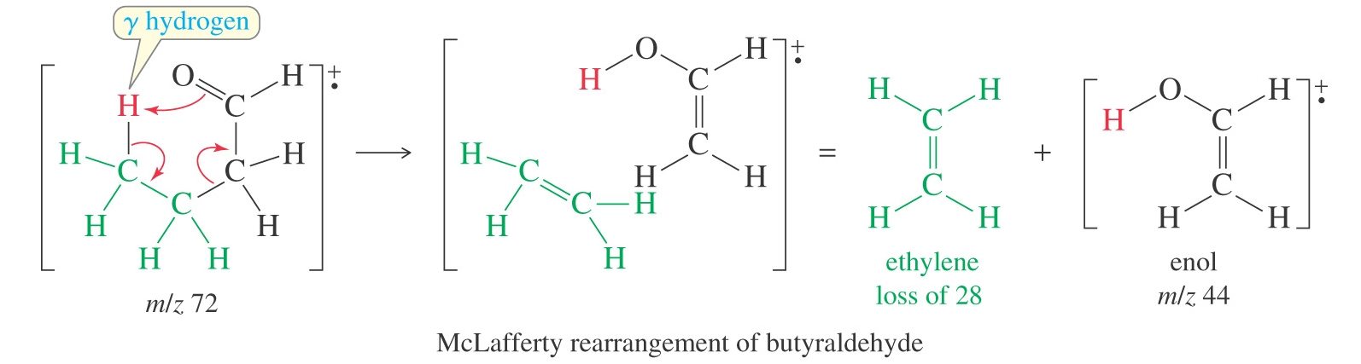
FRAGMENTATION PATTERNS
McLafferty rearrangement splits
McLafferty rearrangement occurs in carbonyl compounds only if the γ (gamma) carbon carries a hydrogen atom.
Fred Warren McLafferty, American chemist born in Evanston, Illinois in 1923 and best known for his work in mass spectrometry, especially for the McLafferty rearrangement reaction that is observed in mass spectrometry

Slide 42
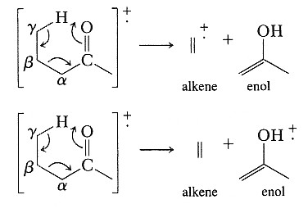
FRAGMENTATION PATTERNS
McLafferty rearrangement splits
Examples
Predict the major fragments observed in the mass spectrum of the following compounds
(a)
(b)
(c)
Problems 15.46 to 15.47 P. 726, 15.49 to 15.53 P. 727
15.59-15.6 P. 728

